Slide 1
Sean Koppenhafer, Jaime Rodriguez,
Chad Thueson, Noah Erickson, Rishal Dass
Weekly meeting, 4/1/2015
Digital Dash
Portland State University
Department of Electrical and Computer Engineering (ECE)
Notes:
1
1

Slide 2
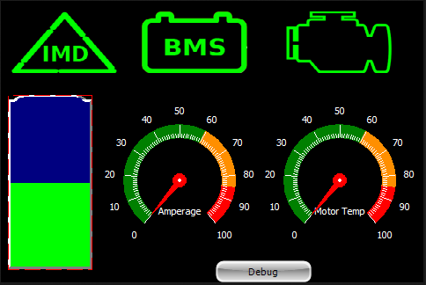
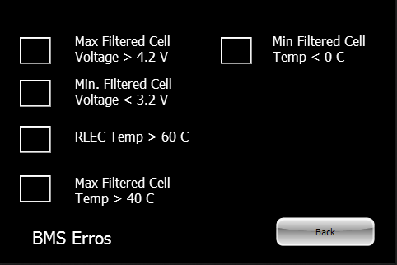
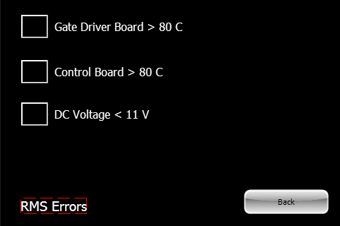
Display Updates
GUI
- Main screen has been designed
Subsystem menus
- Additional screen options to troubleshoot

Slide 3
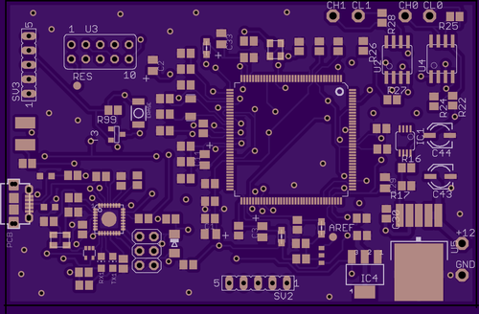
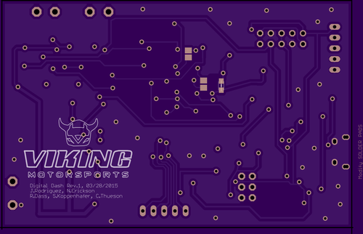
Board Layout
Schematic has been finalized
- component selection(0805, alternatives)
- BOM Created
- w/ power supply
Layout Rev 1
- Constraints ( DIMs, Trace widths, LQFP)
- Team Logo

Slide 4
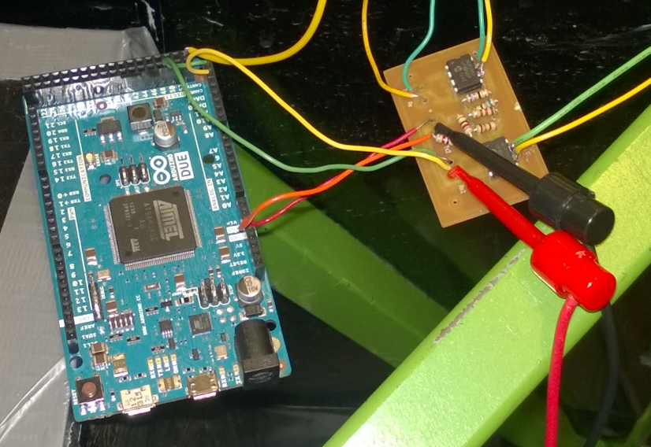
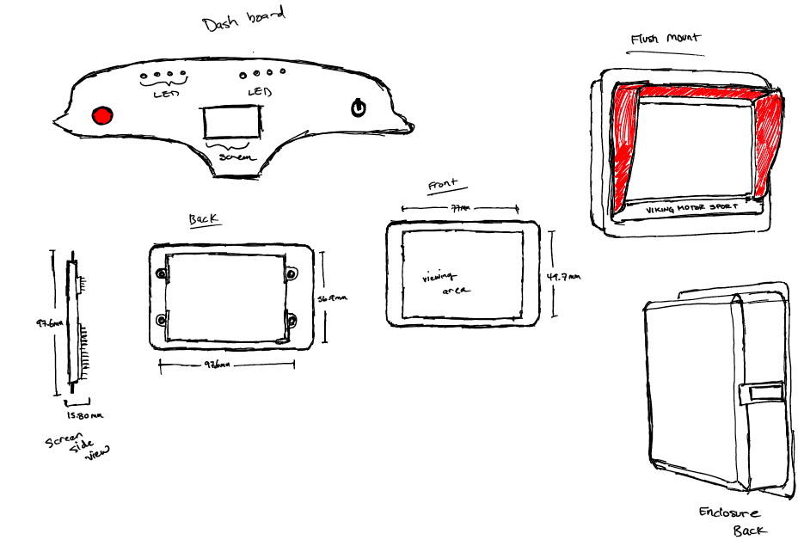
Prototype Enclosure
Created enclosure Design for Due Prototype
For upcoming test runs
Need to redesign transceiver board
Design 5v Power supply board

Slide 5
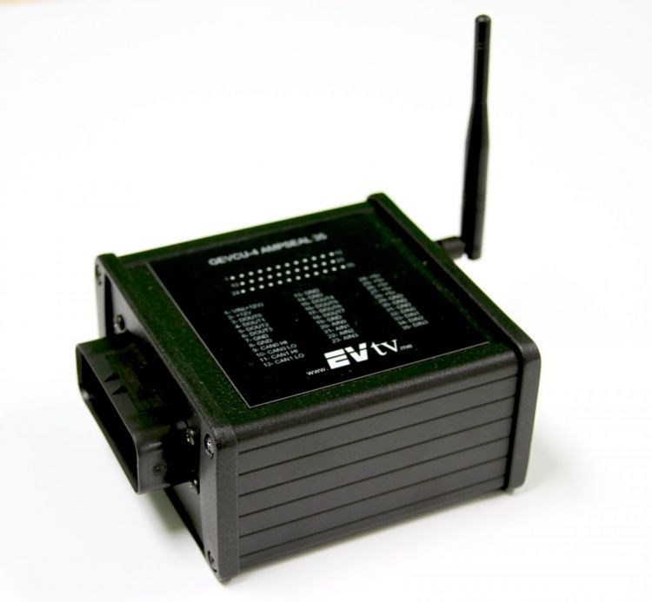
CAN Updates
BMS ( Issues)
RMS (Completed)
BMS intermittently working, have been able to receive messages a few times but there seems to be an issue with our system interrupting the communication between the EVCU and BMS.
Solution
Not sure how to fix issues, since car has been taken part and wont be back together for unknown # weeks.
RMS messages confirmed as accurate.
Correct scaling factors found.

Slide 6
Goals For The Upcoming Week
Board
- send layout to board house for manufacturing.
- order parts
Enclosure
- Create enclosure for Due Prototype, for upcoming test run.
- clean up transceiver board
Code Cleanup
- Continue to tidy up the code
Notes:
6
----- Meeting Notes (4/1/15 10:34) -----
keep doing what we doing
listen to what michael says
problems out of control

